Slide 1
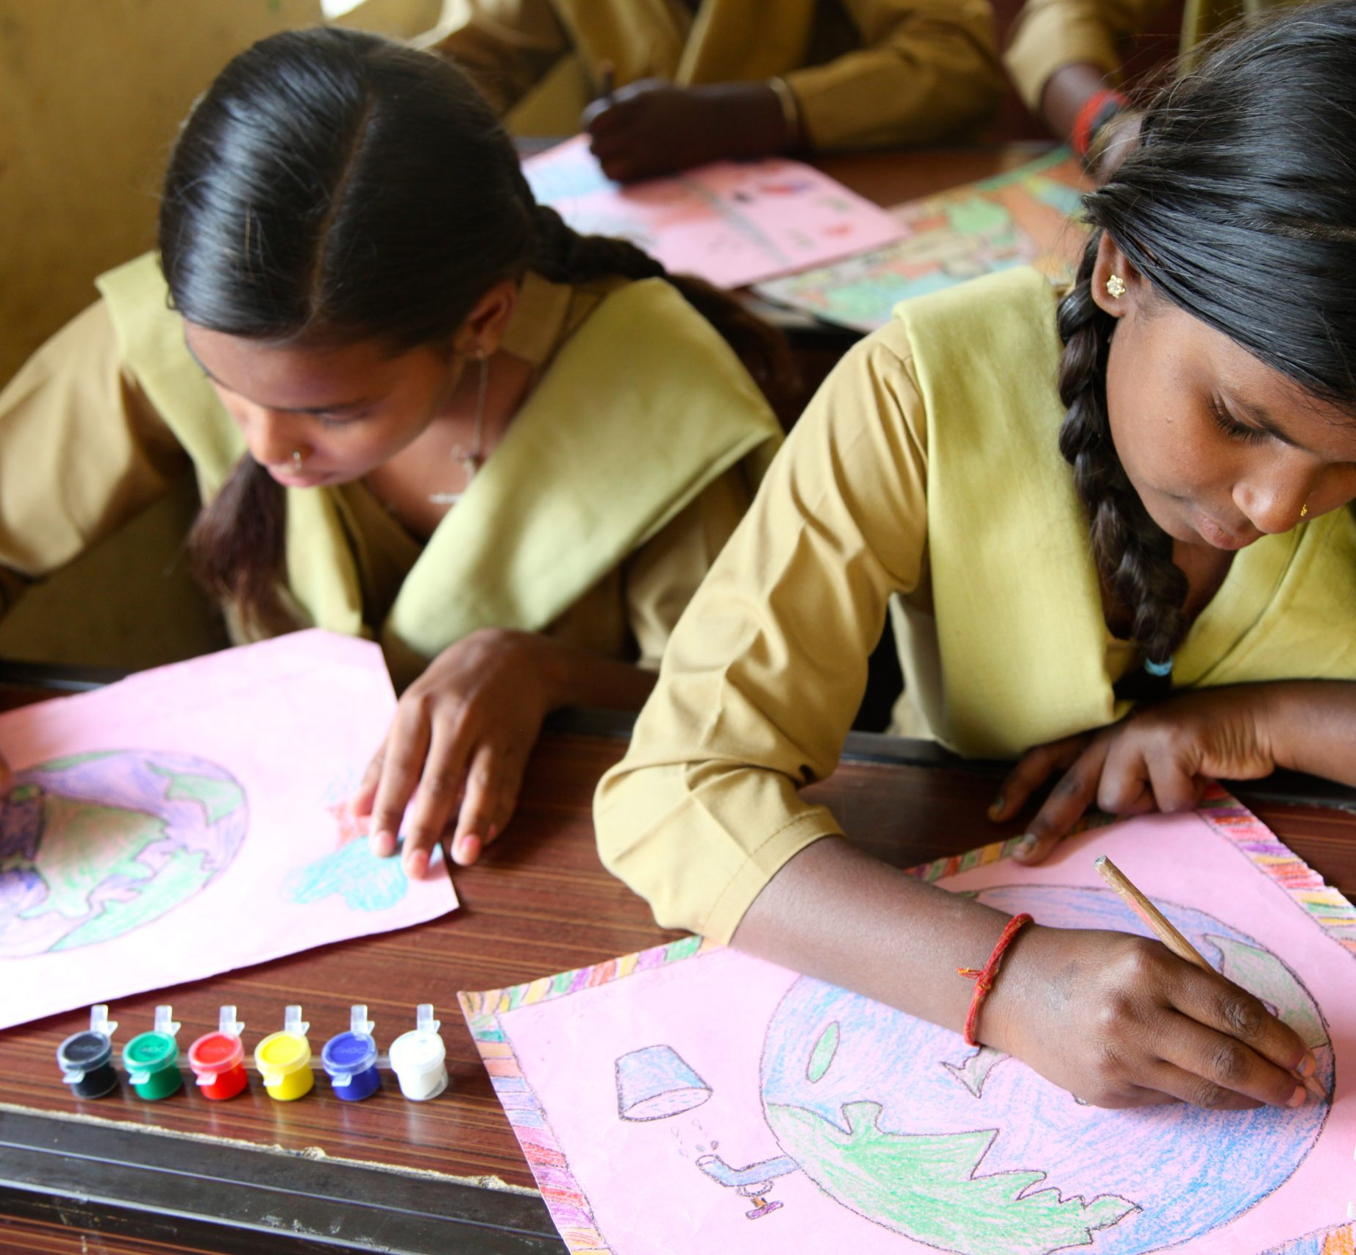
About Us
An Introduction
Notes:
Please note that the cover needs to be regionalised
Always add the title on the first slide

Slide 2
Empowering Change
from Mumbai to the World!
Our journey began in 1991 in Mumbai, India, where Jeroo Billimoria, working at the Tata School of Social Studies, launched a project to bridge societal divides by bringing children together to learn about each other’s lives. This initiative, rooted in children’s rights education, evolved into a global movement. From addressing inter-ethnic tensions to promoting financial and social literacy, Aflatoun has always championed the power of knowledge to create change. By 2005, we became a global organisation headquartered in Amsterdam, and since then, we have reached millions of children and youth worldwide, helping to grow empowered citizens and resilient communities.
Notes:
1. This slide is useful for a slide deck package to donors – we do not have to use it for general presentations led by RCs (to partners) or for management when presenting at the events.

Slide 3
Our Purpose and Aspirations
Mission
Ensure access to quality, inclusive, child-centred social and financial education for all children and young people, especially the most vulnerable.​
Vision
Socially and economically empowered children and young people who act as agents of change in their own lives for a more equitable world.​

Slide 4
What is Aflatoun International?
!
We are the world’s largest social
and financial education network
Since 2005, Aflatoun International is a network of organisations who has been developing Social and Financial Education programmes allowing children and young people to break the intergenerational cycle of inequality. The programme seeks to empower children to believe in themselves, know their rights and responsibilities, understand and practice saving and spending and start their own innovative enterprises.

Slide 5
The Social Franchise Model
Aflatoun’s programmes are implemented by partners worldwide through an innovative social franchise model. This dynamic, bottom-up network of interlinked partner organisations is based on reciprocal empowerment, supported by Aflatoun International. This is a high-impact, low-cost model which accelerates scale-up of Aflatoun’s programmes, through integration into national curricula and increasing the number of local partners reaching vulnerable children and young people.
32.8
350+
million children and youth reached through national integration
3.3
Secretariat
partners implementing
our programmes
In 110+ countries
million children and youth reached through the partners network

Slide 6
What we do?
That is what creates our unique Social Franchise Model!
Support and Collaboration Within the Aflatoun Network
Develop educational resources both for offline and online delivery
Provide capacity building to partners on how to contextualize and deliver SFE programmes
Provide technical assistance to governments on how to scale SFE at the national level
Fostering lasting partnerships and support through local, regional, and global advocacy efforts
Monitoring and Evaluation of implemented programmes & methodology
Connecting partners globally to share impactful practices

Slide 7
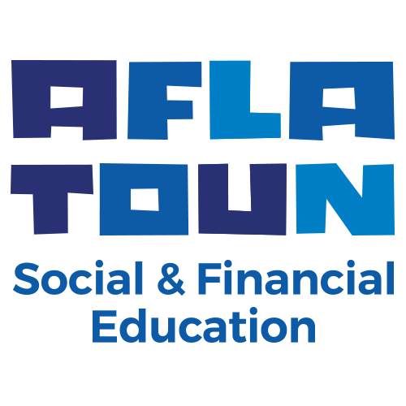
Scaling Financial Education Through Localized Approaches
66.728
children reached
Peru
Network of NGOs
1.501.835
children reached
Philippines
Cooperative Movement & Ministry of Education
638.165
children reached
Jordan
Government + NGO + Private Sector
Central Bank/MoE/
Private Sector
Proven models to scale financial education, reaching millions globally!

Slide 8
Our Theory of Change
Positive
Attitudes
Social Awareness
Financial Skills
Practice
Social and Economic Empowerment
Notes:
Slide preffered by Roeland + corrected visually.

Slide 9
Our Theory of Change
Personal Understanding & Exploration
Rights & Responsibilities
Saving & Spending
Planning & Budgeting
Social & Financial Enterprise
Positive
Attitudes
Social Awareness
Financial Skills
Practice
Social and Economic Empowerment

Slide 10
Three Elements to Energise Children Worldwide
Content & Tools Fuel Source
Method
Ignition
Network
Oxygen

Slide 11
Three Elements to Energise Children Worldwide
1
Content & Tools (Fuel Source):
Our education resources provide the fuel, building various essential life skills on a basis of social and financial skills education.
Children build socioemotional skills and awareness about rights and responsibilities, sound financial habits and understanding, and many even build small social and financial enterprises.
Content & Tools Fuel Source
Method
Ignition
Network
Oxygen

Slide 12
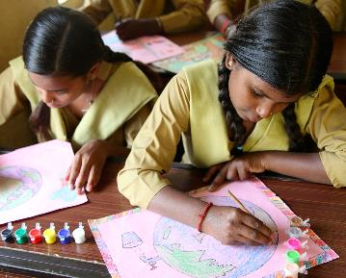
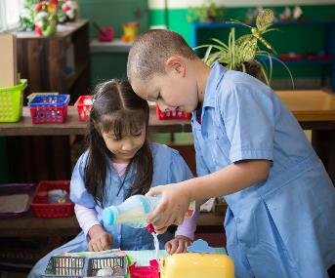
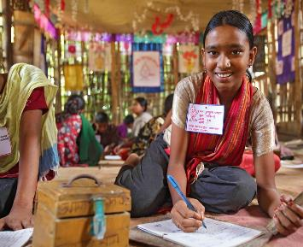
Aflatoun Life Skills, Financial & Entrepreneurship Education
Five Core Elements
1
2
3
4
5
Personal Understanding & Exploration
Rights
&
Responsibilities
Saving
& Spending
Planning
&
Budgeting
Social & Financial
Enterprise

Slide 13
Three Elements to Energise Children Worldwide
2
Method (Ignition):
Our Active Learning Methods (ALMs) provide the heat and ignite the spark.
Trainers and teachers learn how to really engage their learners and make learning exciting, fun, and relevant, which changes everything.
Content & Tools Fuel Source
Method
Ignition
Network
Oxygen

Slide 14
Active Learning Methods
Aflatoun International focuses on learning through action and this already starts at an early age, when children’s habits are forming. ​
With Aflatoun’s Active Learning Methods, students actively participate in class which focuses on interpersonal and cognitive competencies such as cooperation, negotiation and leadership, as well as problem-solving, analysis, critical thinking and decision-making.

Slide 15
Trainings and capacity building
What TYPE OF TRAINING does Aflatoun offer?
Teachers who use child-centered, participatory teaching methods in the classroom, as well as NGO facilitators working with children and youth outside of school, are essential for the successful delivery of Aflatoun’s content.
Our training ensures that educators can make the most of Aflatoun’s materials while also enhancing their overall teaching and facilitation skills.
We believe that teachers and facilitators should be beneficiaries of the programme just as much as the children and youth. This is achieved through a global network of Regional Master Trainers, many of whom work within teacher training institutes and other organizations.

Slide 16
Trainings and capacity building
What TYPE OF TRAINING does Aflatoun offer?
Aflatoun Certification Programme: ATMPC
Capacity Building on Digital Learning, MERL, Communications, Fundraising, etc.
Core Curricula Training on AflaTot, AflaToun, AflaTeen and AflaYouth

Slide 17
Three Elements to Energise Children Worldwide
3
Network (Oxygen):
Our global network of partners provides the oxygen, unleashing a global movement.
In over 100 countries, partners adapt and contextualise our educational resources, reaching millions of children. Governments and bi- and multilateral agencies in 40 countries integrate our educational resources in national curricula and projects, giving more and more children access to essential life skills and financial education.
Content & Tools Fuel Source
Method
Ignition
Network
Oxygen

Slide 18
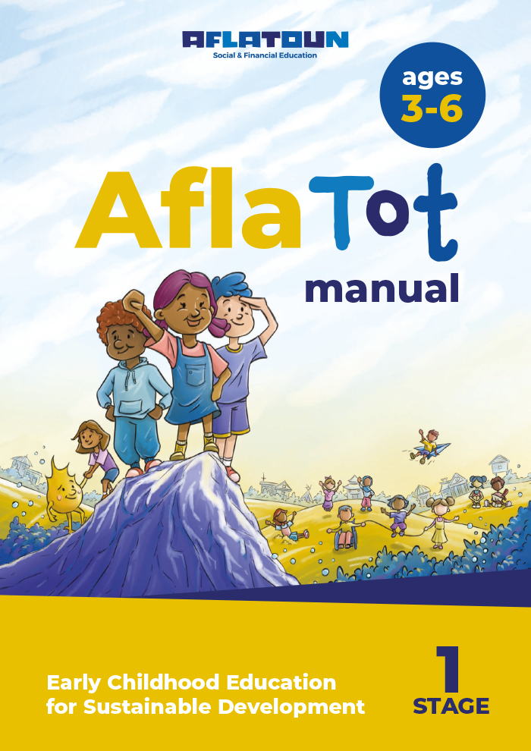
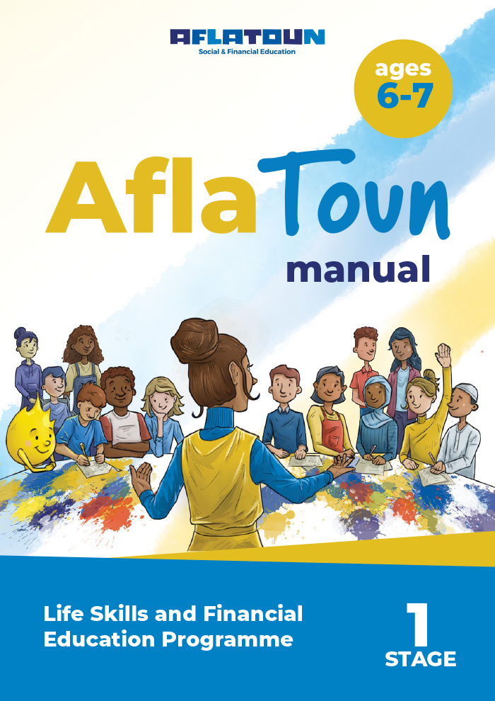
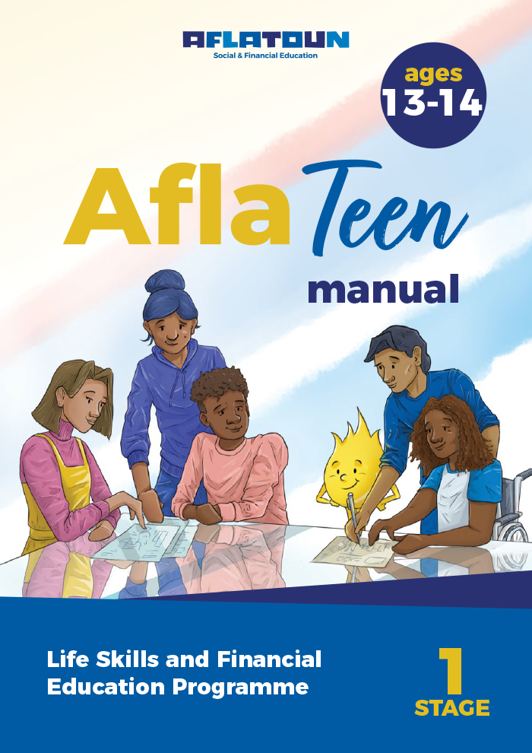
Ignition – How we do it?
Our core programmes
Aflatoun creates high-quality curricula, for different age groups, which are contextualised and implemented by local partners.
Educators are provided with training to teach the Aflatoun child-centred active-learning method (offline and online), boosting life skills and financial education through the 5 core elements. Currently, the content is under revision to fully integrate digital and green skills.
Notes:
AflaYouth cover to add on asap

Slide 19
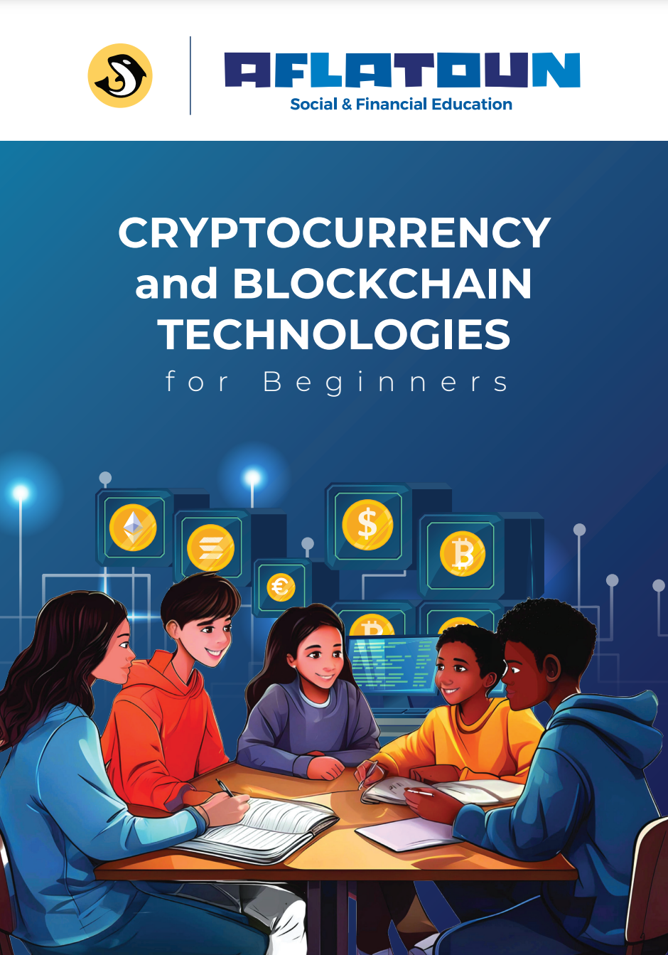
Our Supplements: Addressing Local Challenges
Notes:
Crypto cover added

Slide 20
Contextualisation and Local Ownership: Empowering Country-Level Adaptation
Aflatoun Curricula
Aflatoun partners are empowered to localise and contextualise the materials to ensure they align with specific cultural, social, and educational needs. This allows them to adapt the curricula to fit local circumstances or complement existing programmes effectively.
Regional and national versions of the curricula have been developed in 50 languages, addressing diverse issues and reflecting the unique realities of each community.

Slide 21
Examples of Local Contextualisation of Aflatoun Curricula
Skills Development Programme for Young Mothers in Tanzania
In Tanzania, adolescent mothers often drop out of school due to societal shame and face significant challenges when trying to re-enter public secondary education, leaving them excluded from formal education. Recognizing these unique barriers, Aflatoun, with the support of Mastercard Foundation, worked with Karibu Tanzania Education and 41 Fold Development Colleges to adapt its Life Skills and Financial Education curricula.
Read more examples of contextualisation here
Read Peace, Siwema, and Advina’s impact stories.

Slide 22
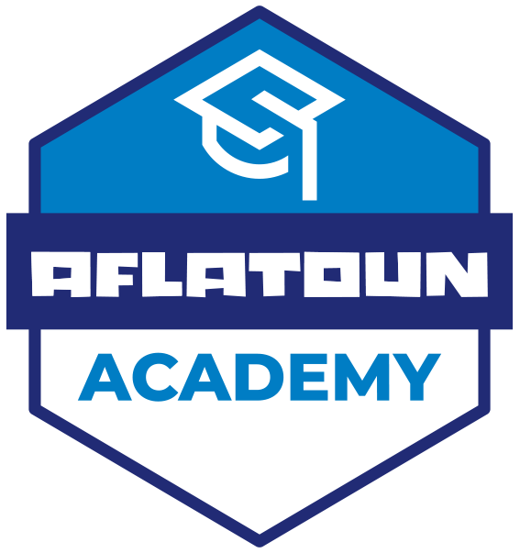
Empowering Educators Through Certification
Aflatoun Certification Programme
Our training ensures educators can use Aflatoun classroom materials to their best advantage and focuses on making them better teachers in general. We believe that teachers should be beneficiaries of the programme as much as children.
AMTCP (Aflatoun Master Trainer Certification Programme)
Notes:
Hidden as we do not talk about SFEC

Slide 23
National Integration: Integrating Into National Education System, Driving Inclusion and Quality at Scale.
National Integration is a means to expand access to quality and relevant education by integrating social and financial education into national or regional curricula.
Integration into the national education system can be achieved through infusion into core curricula, creating a standalone subject, or adding an extracurricular activity.
It is crucial to align curriculum integration with the country's broader financial inclusion strategy.

Slide 24
The Steps to National Integration
2
3
1​
Curriculum Framework Development​​
Governance
Policy Formulation
Aflatoun to introduce our curriculum, to identify where SFE can be integrated, and to suggest the integration approaches
Aflatoun to assist in setting up the subjects, lesson plans, hours, road maps and stakeholders
Aflatoun to advocate SFE, to bring the key actors together, and coordinate efforts of the different sectors.​​
7
Assessment
4
6
Materials
Implementation
5
Aflatoun to support the evaluation of implementation of curriculum
Training
Aflatoun to help develop materials used in classroom (manuals, textbook)​
Aflatoun to support as necessary in the roll-out or piloting of implementation by the country​
Aflatoun to deliver master training and teachers training​

Slide 25
Proven Value: The Economic Impact of Social and Financial Education
Every $1 invested in SFE=ROI of up to:
$2.5 (by the age of 25)
$12.5 (by the age of 34)
We commissioned a Cost-Benefit Analysis (CBA) of investing in Social and Financial Education when integrating it into National Education Systems.
The CBA of Comprehensive Social and Financial Education across 110 countries provides compelling evidence for the significant socioeconomic returns of such an investment.
Benefit-cost ratio (BCR):
13.2
53.5%
Improvements in socio-emotional skills
43.5%
enhanced employability and entrepreneurship

Slide 26
Our Impact Evaluations
Over 100 evaluations conducted across 52 countries reveal the measurable impact of Aflatoun’s programmes on critical areas such as Financial Literacy, Agribusiness, Peer-Led Education. These evaluations show improvements in skills, knowledge, and opportunities, empowering children and youth to thrive in their communities.

Slide 27
Global Recognition
2016
2018
2019
2021
2021
2022
2023
2024
Notes:
All icons redesigned by Elisabetta.

Slide 28
Our goals for 2026
60 mln
children reached annually with quality Social and Financial Education
Working towards integrating social and financial education
into national education
systems in
60
countries
600
Partners
Notes:
Less yellow – as indicated.

Slide 29
Are you with us? Join our mission!

Slide 30
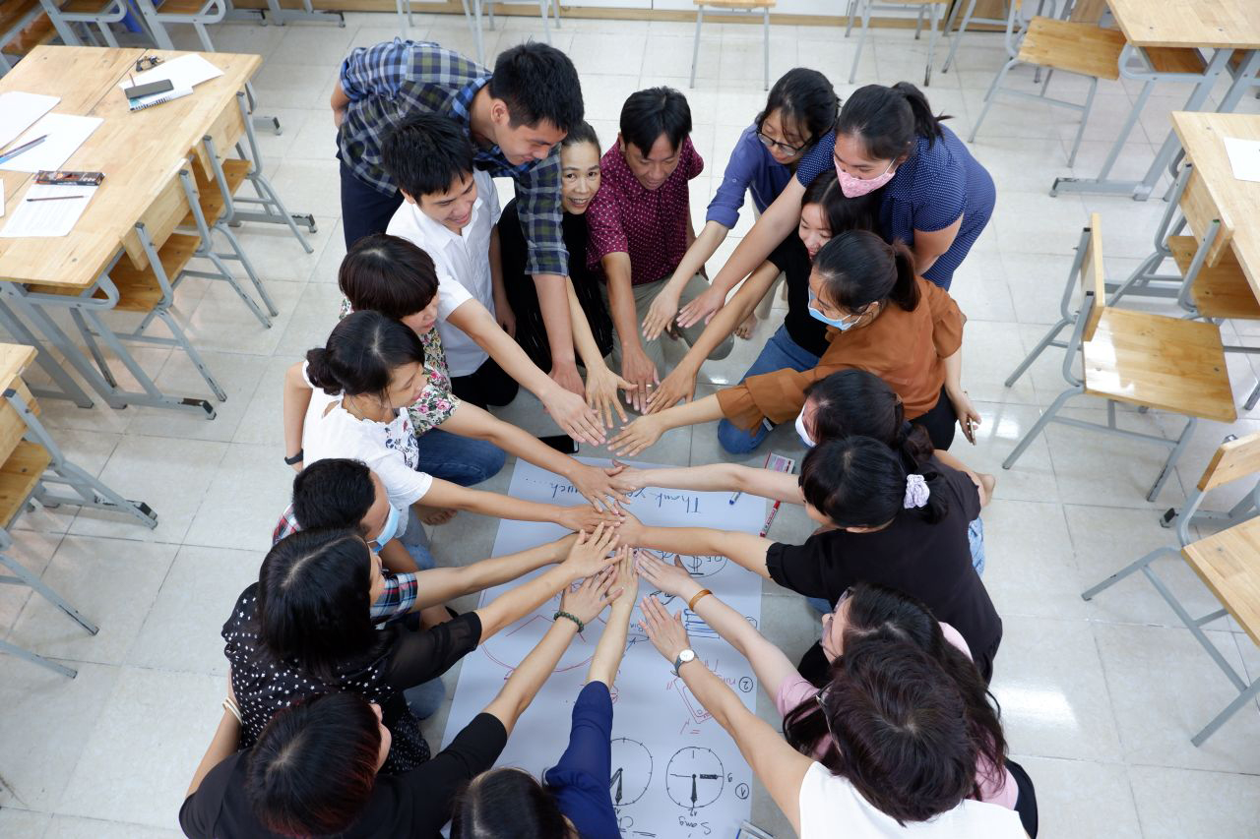
www.aflatoun.org
@Aflatoun_international
@Aflatoun_international
@Aflatoun International
Notes:
- Underline the mention about www as a source of information and relevance when building their own decks

